Slide 1
How to Define, Delineate and Investigate your Local Watershed.
Watersheds and their change over time. What stories are in your watershed?
SWAC Meeting - May 10th, 2012

Slide 2
A Watershed, from Drop to Drain
Define a watershed.
Learn how to track the flow and change over time.
Identify stream health through basic water quality sampling methods.

Slide 3
  Can a watershed be as small as a puddle and large as all of the Great Lakes?
  Can you think of example of a watershed a.k.a. basin inside your home?

Slide 4
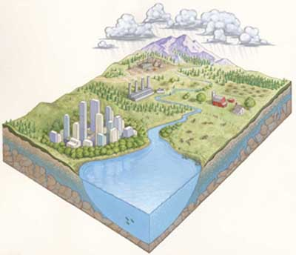
What is a Watershed?
The area of land that drains water, sediment (soil), and dissolved substances into a common body.
http://www.fs.fed.us/spf/coop/images/watershed.jpg
Basins or watersheds are nested.

Slide 5
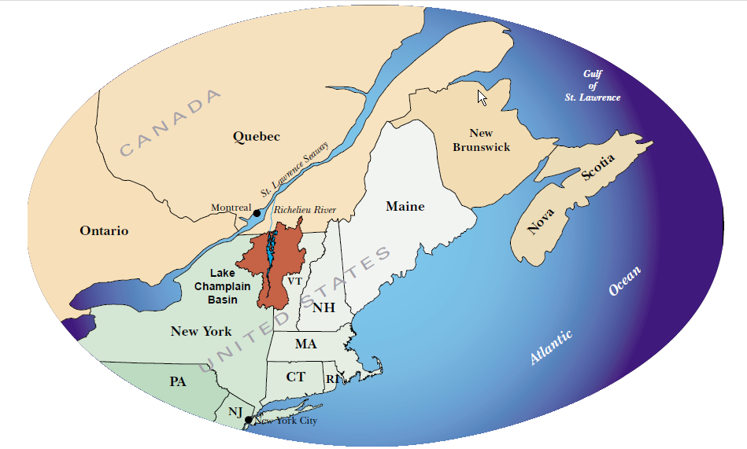



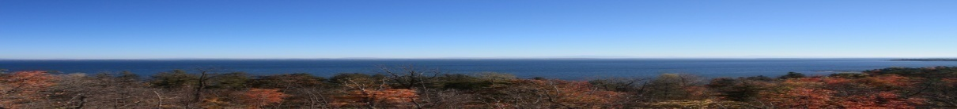

Slide 6
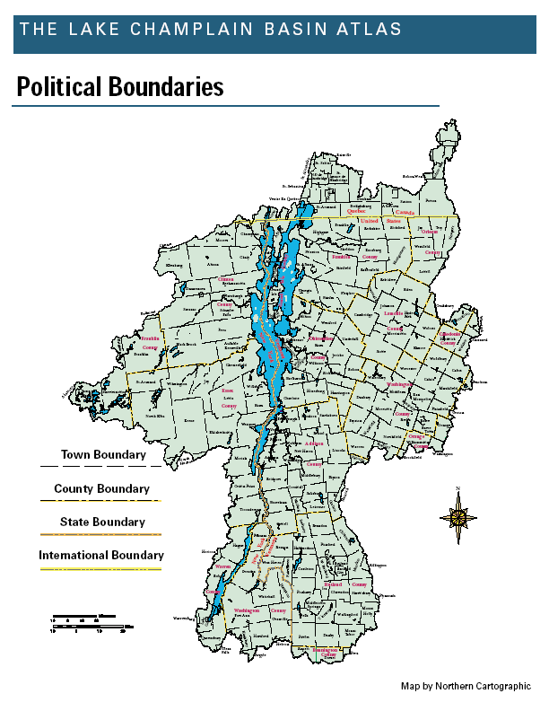

Slide 7
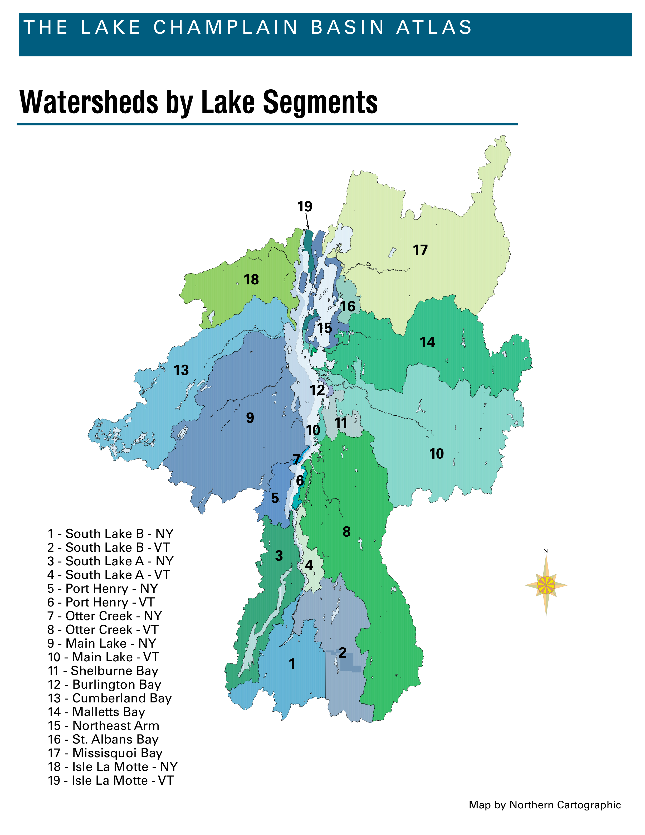
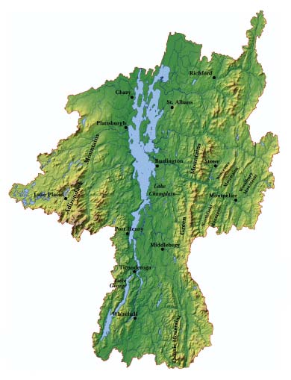
Watersheds within Watersheds
Topography Map of Lake Champlain Drainage Basin

Slide 9
Track the Flow
Delineate a watershed or sub-basin using the maps provided.
How would you calculate the size of this watershed?

Slide 10
Track the Change
Google Earth
Bing Maps
http://m.vpr.net/news_detail/94195/new-google-maps-show-irene-devastation/
UVM Landscape Change Program

Slide 11
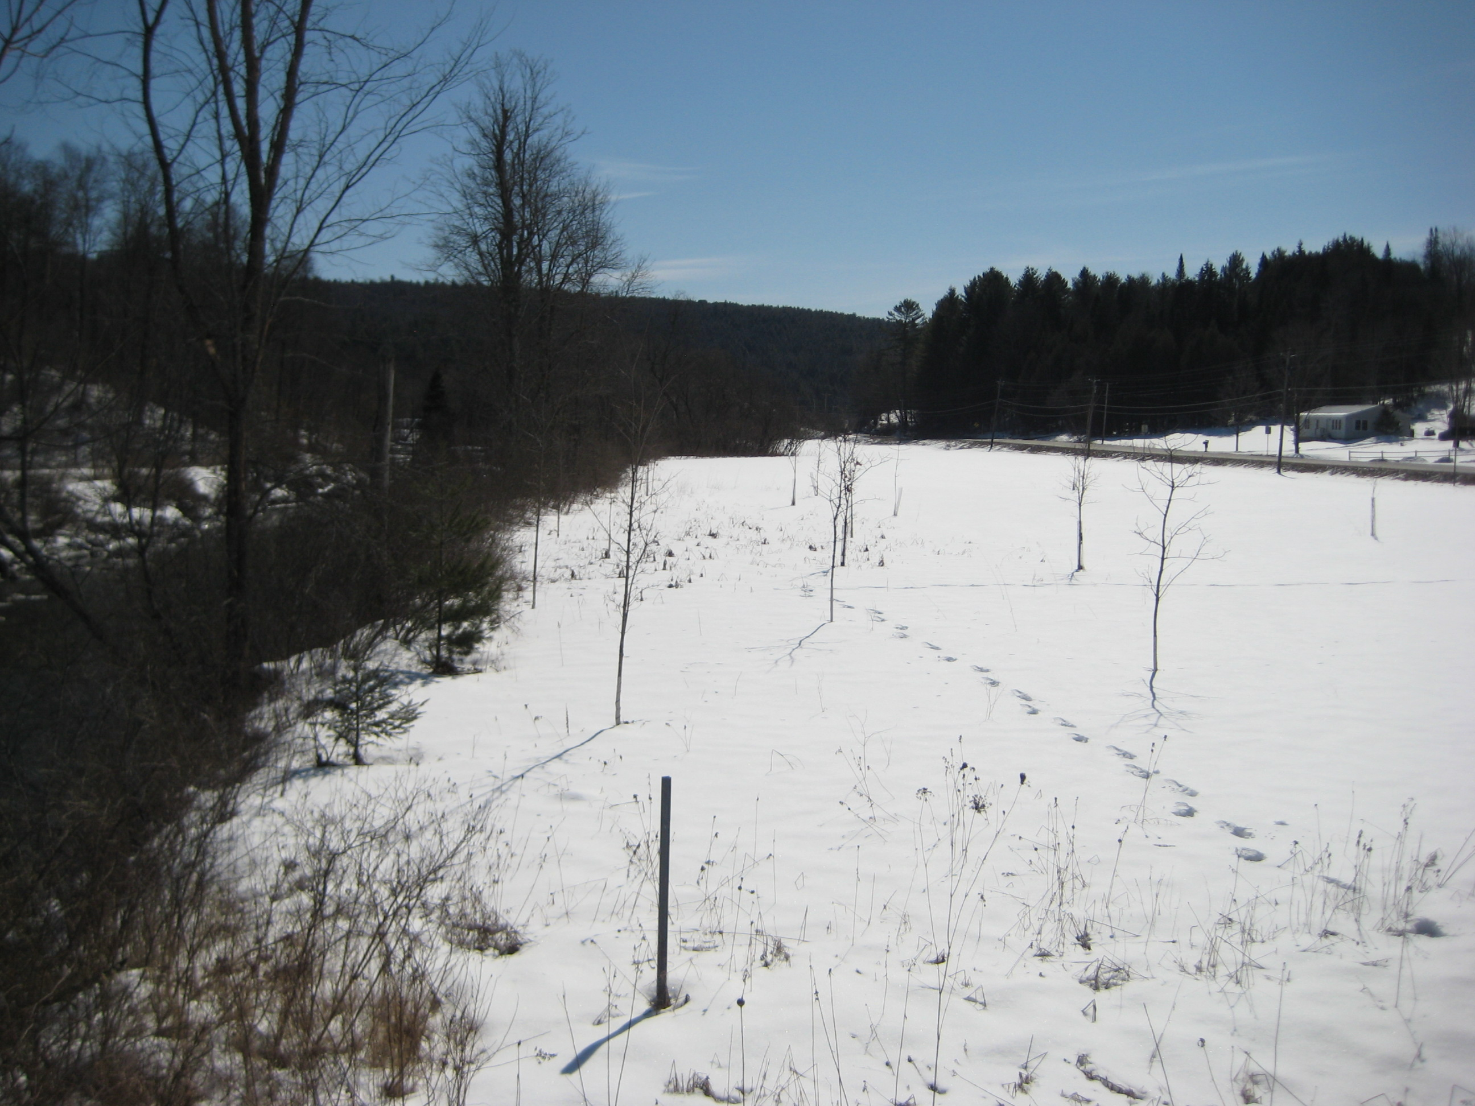
Riparian Buffer Plantings

Slide 12
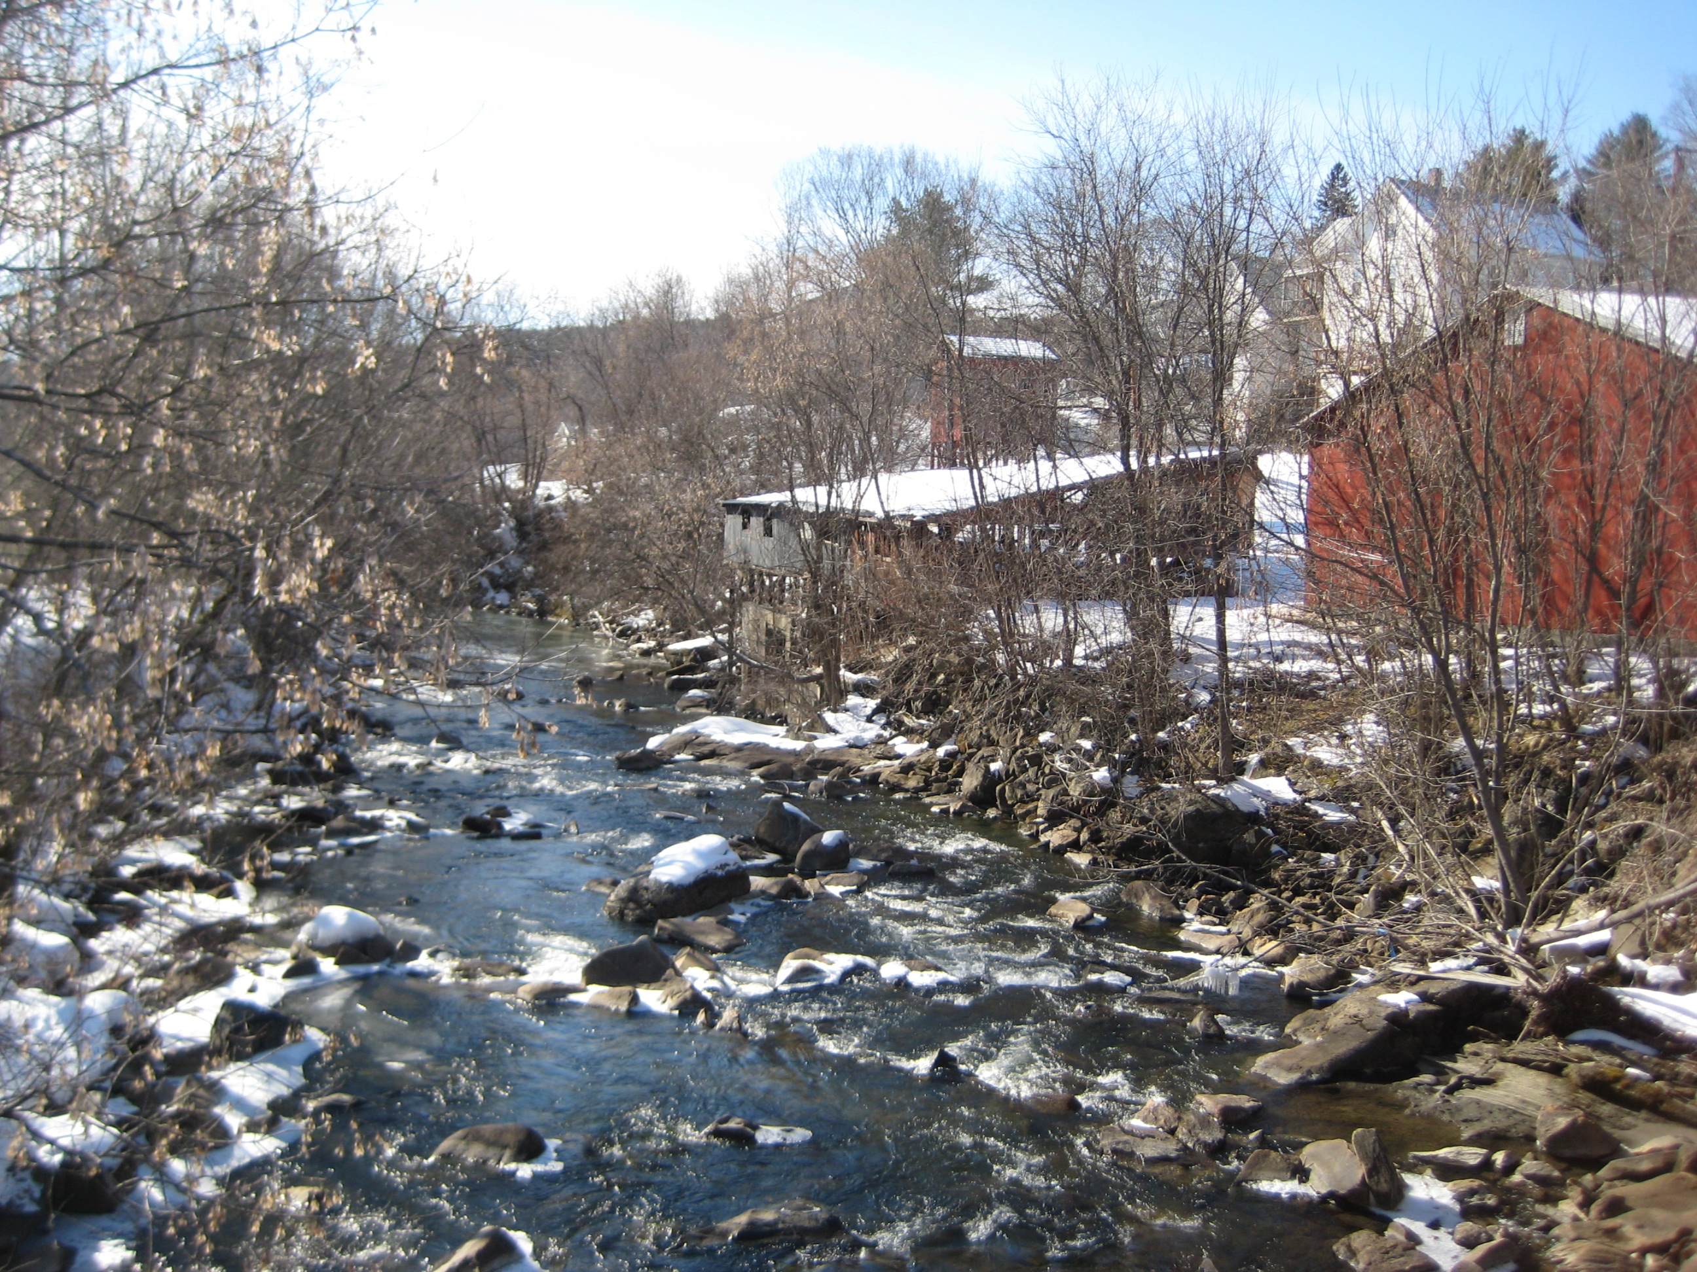
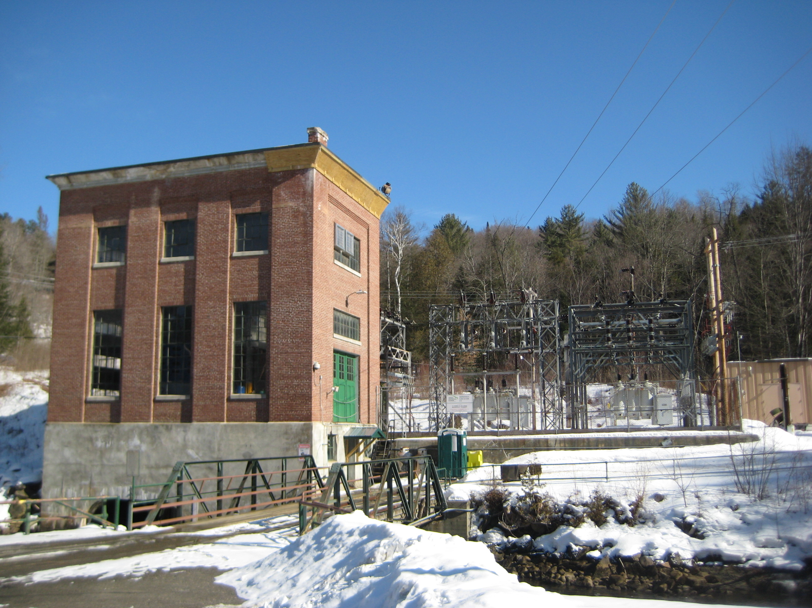
Physical changes in the river
Cobbles, Boulders and Wood
Built infrastructre

Slide 13
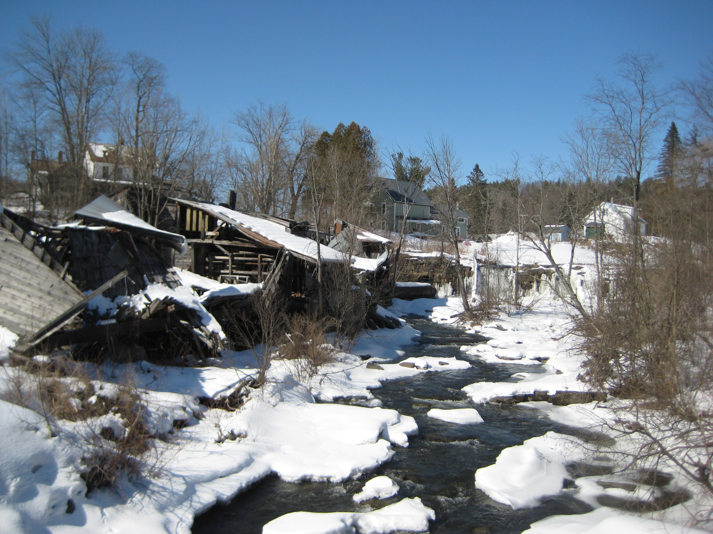
Lower Cabot, Upper Winooski River

Slide 14
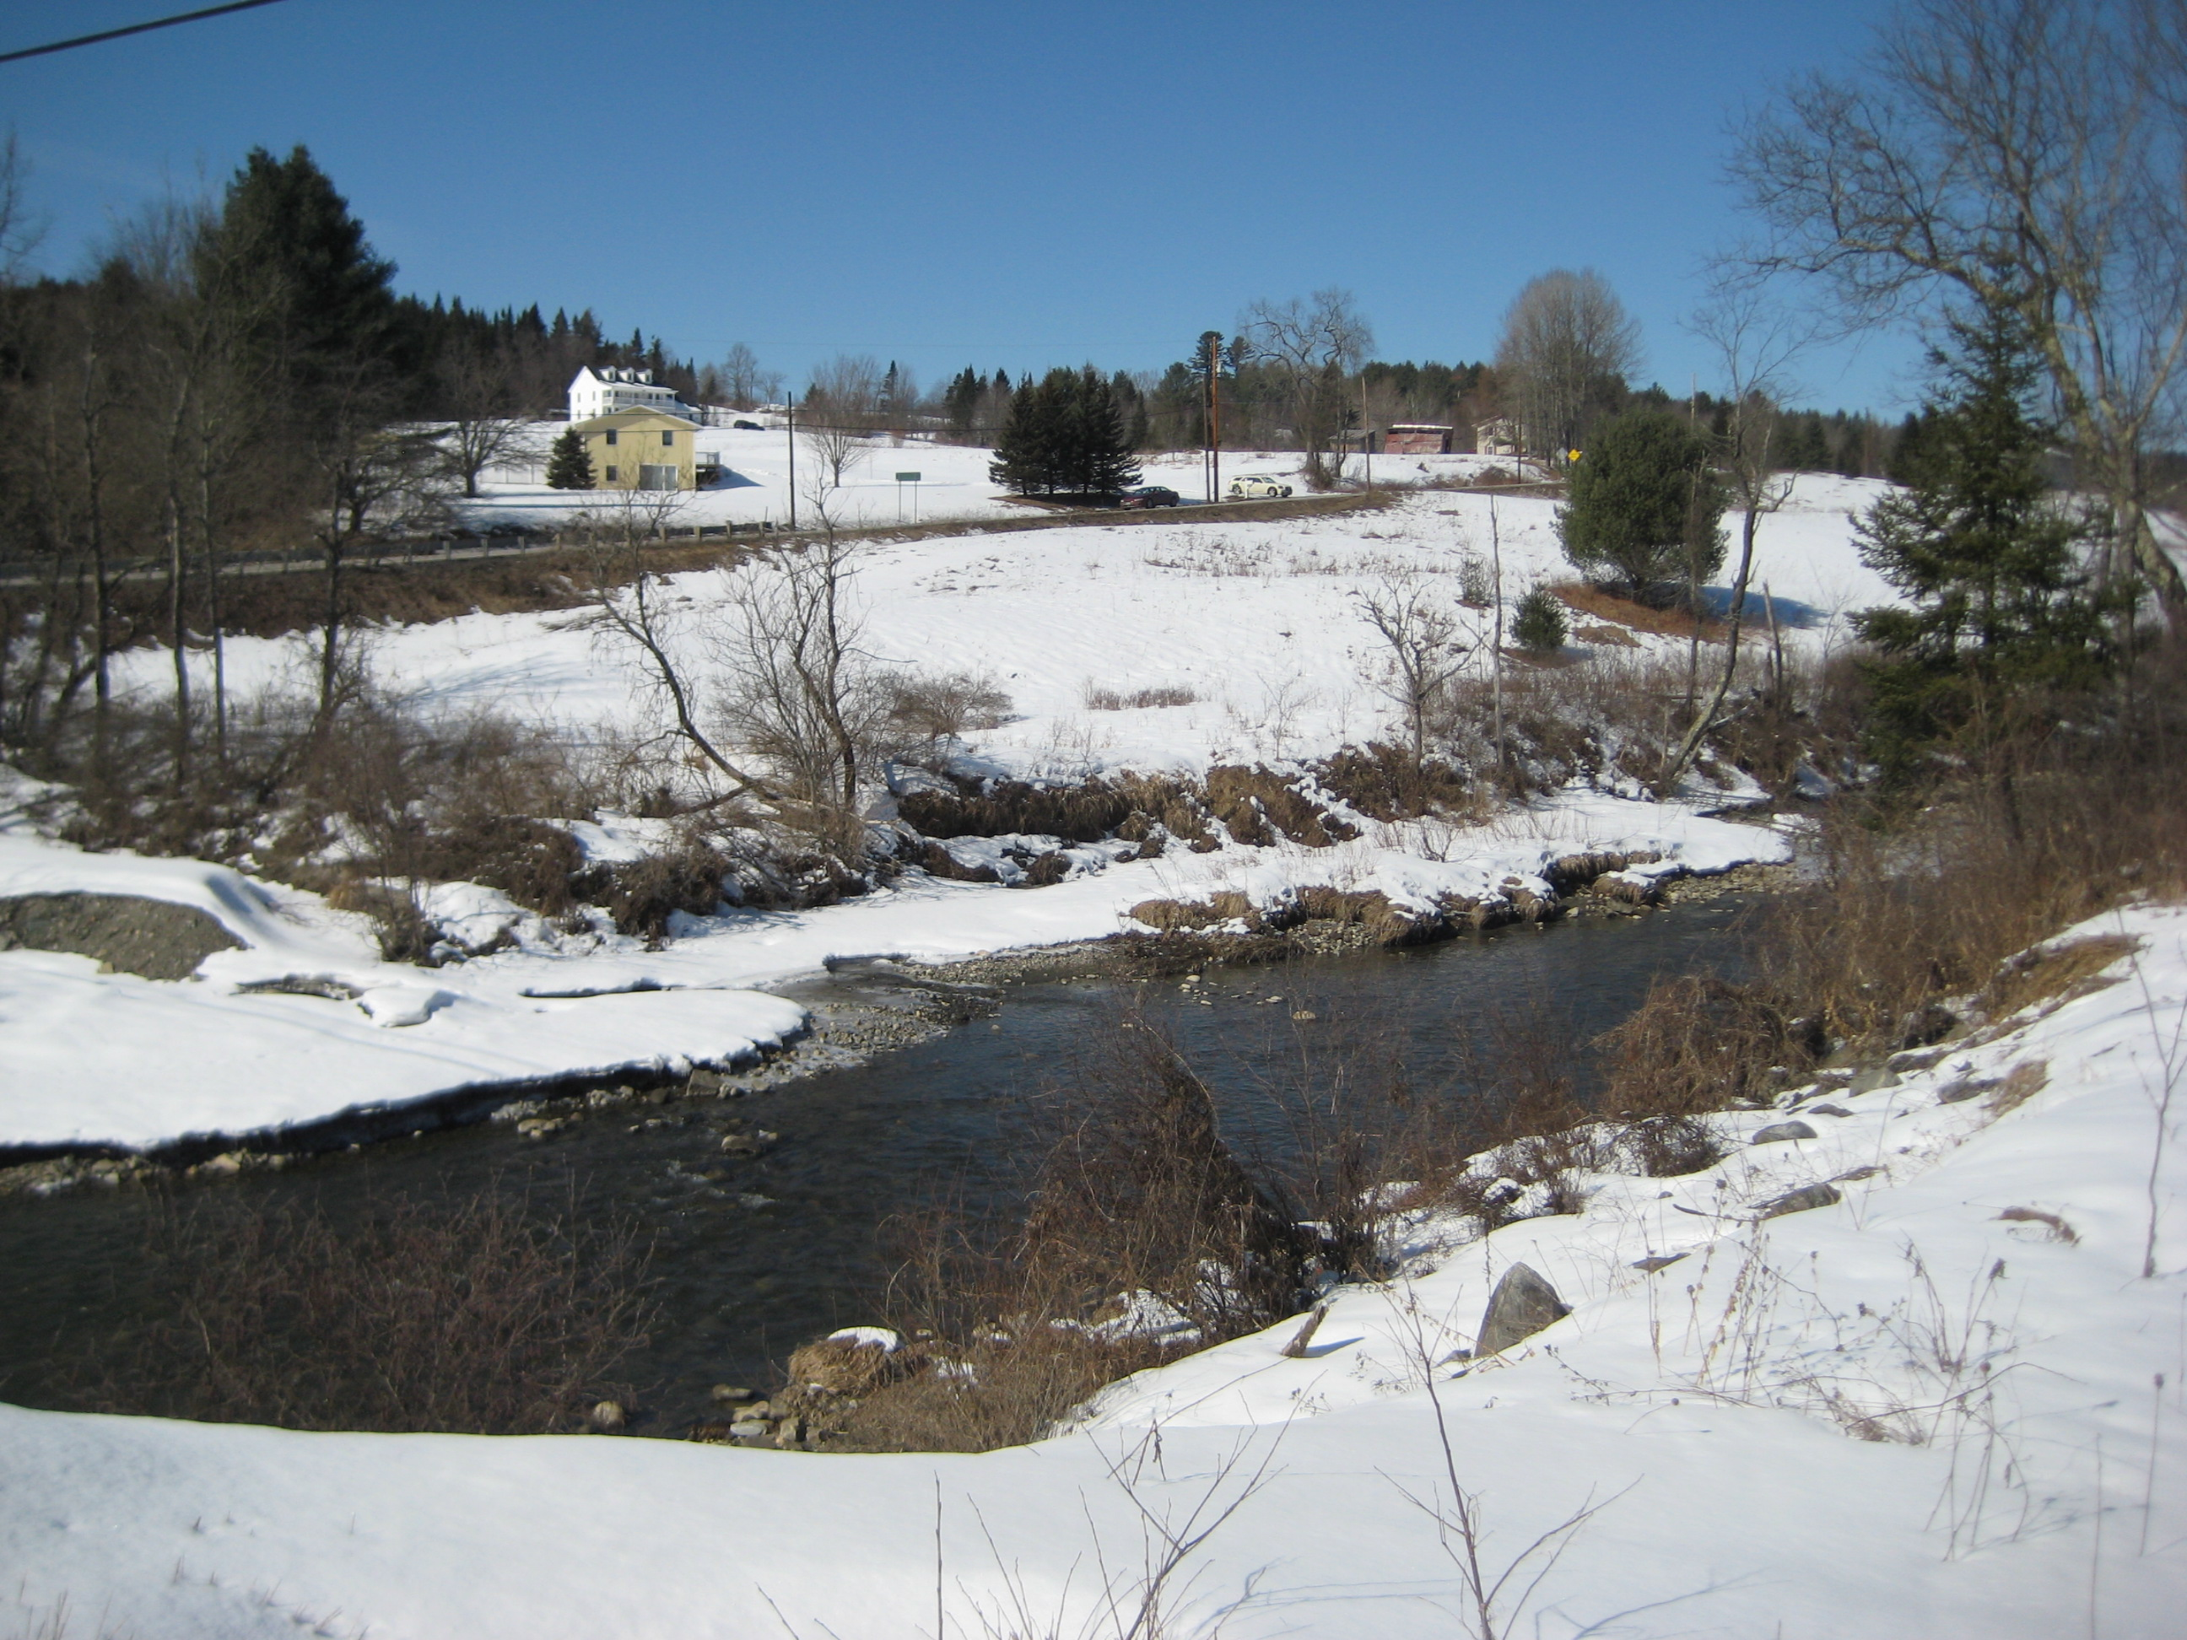
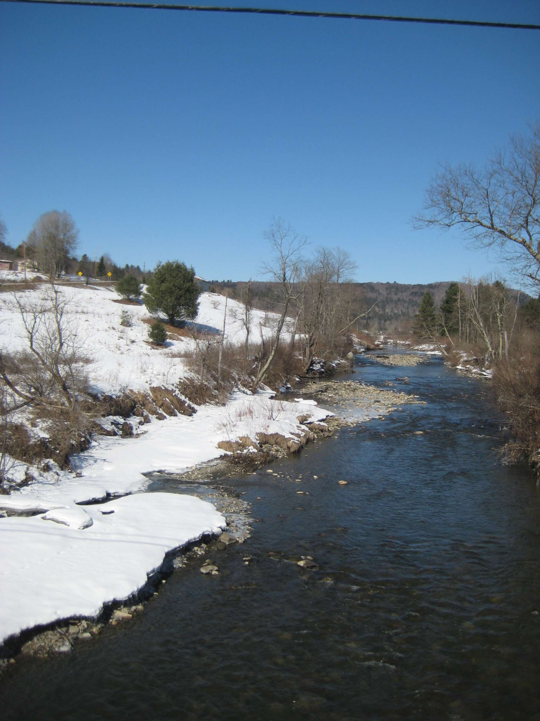
Upper Winooski River a.k.a Headwater Sub-Basin
Plainfield
Upstream view of Winooski River

Slide 15
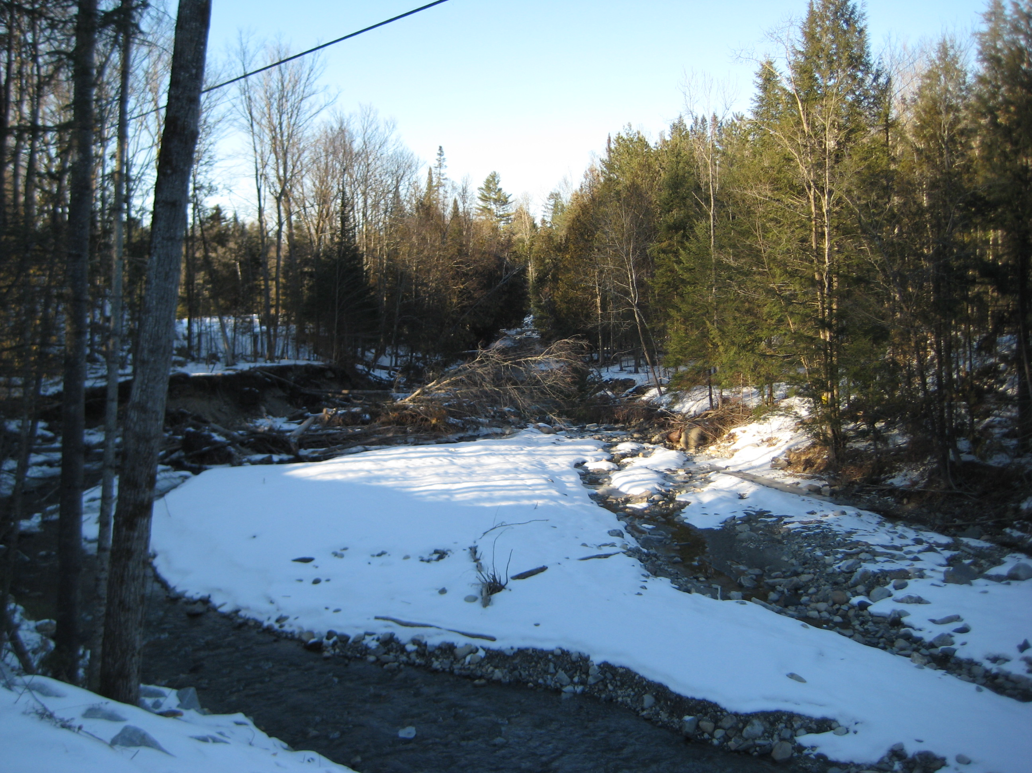
Great Brook, a tributary to the Winooski River

Slide 16
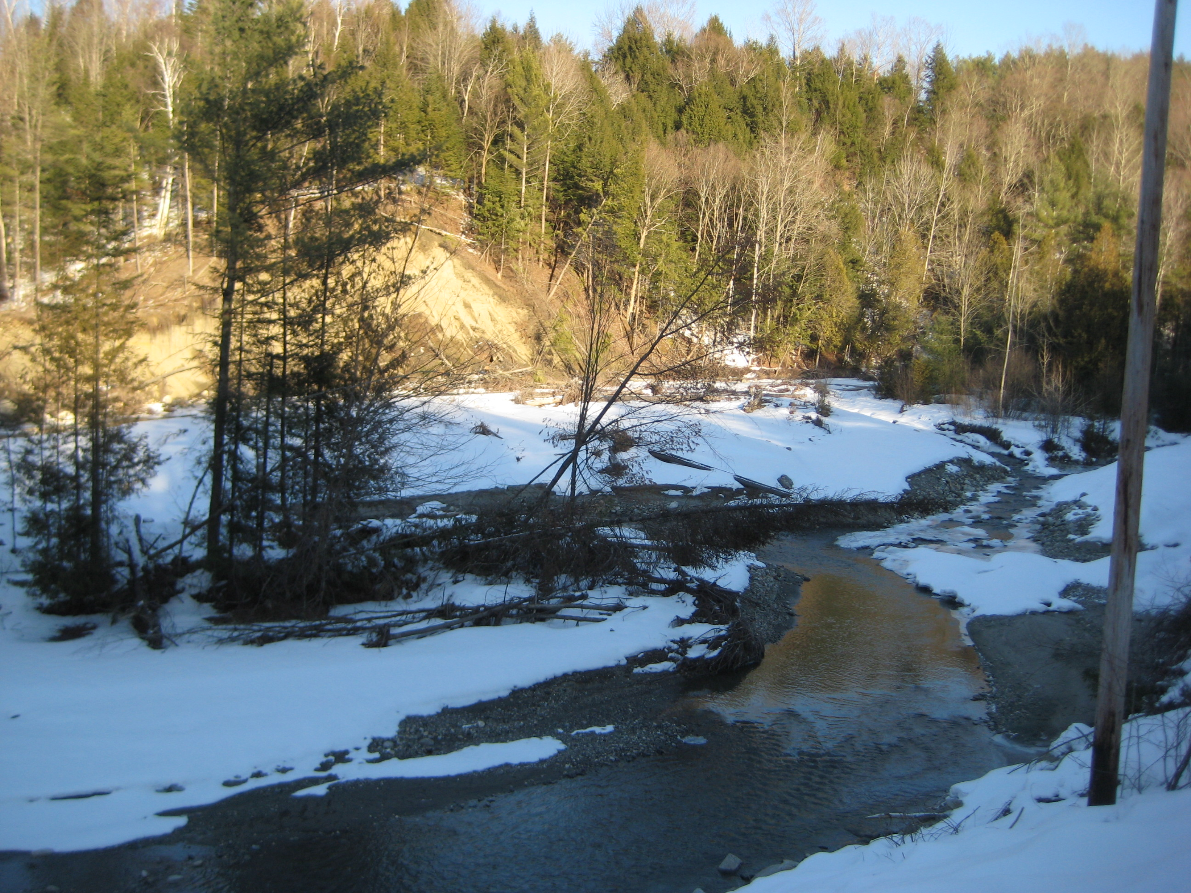
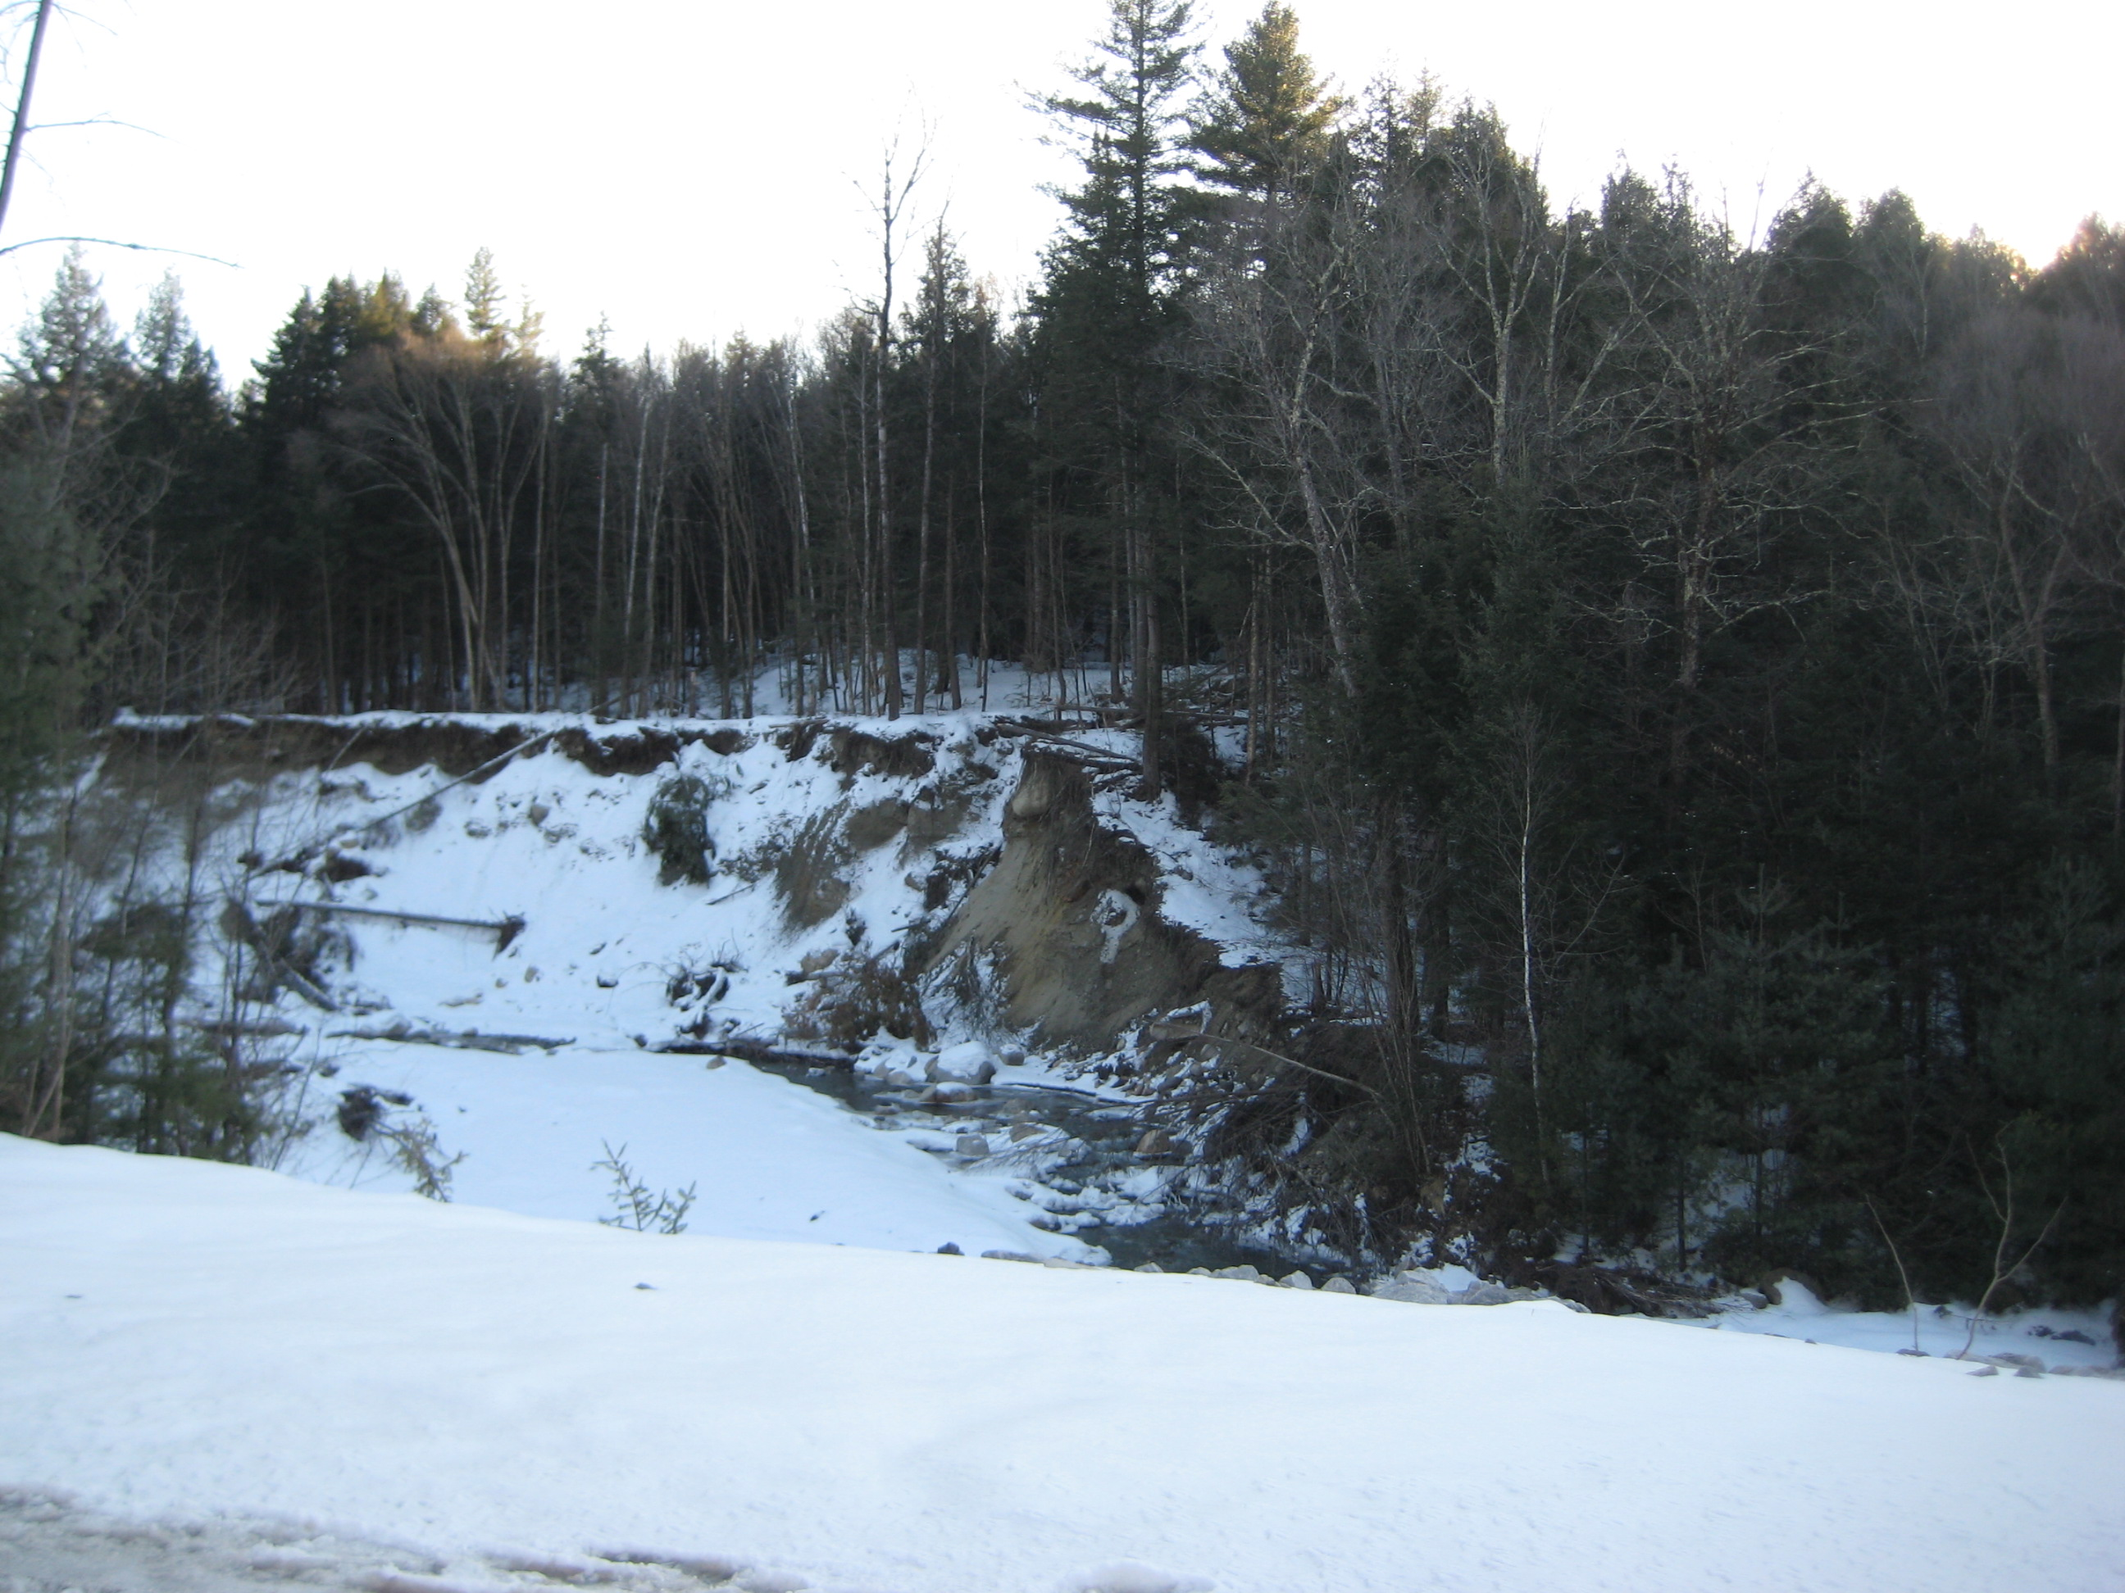
What a flood event and erosive soils do to a stream
Great Brook troubles
Spring 2011 Great Brook flood damage

Slide 17
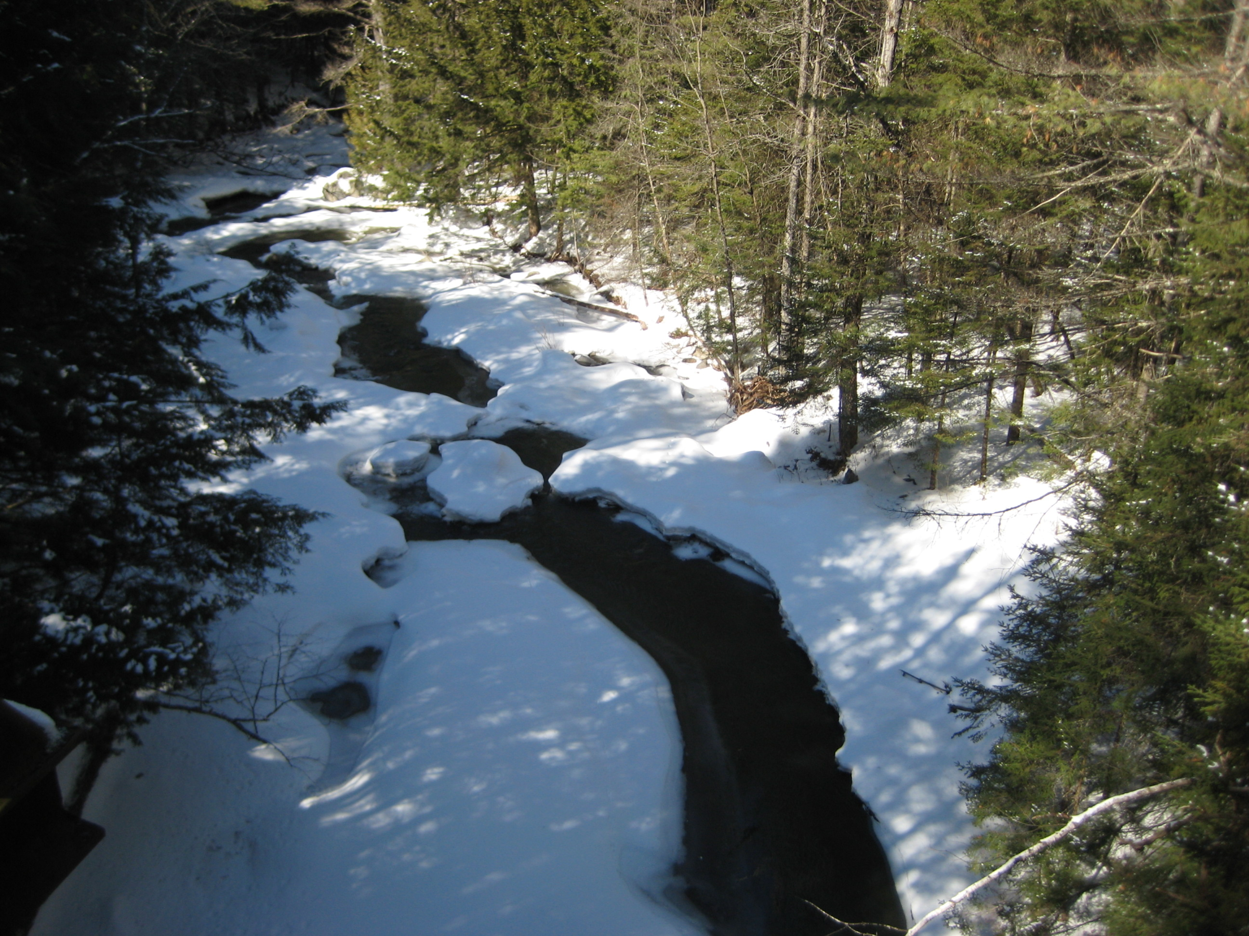
Thank you!

